Slide 1
COVID CASES TRACKER

Slide 2
ABSTRACT
Our application allows the user to view number of covid cases based on user’s choice. User will have number of choices to view number of cases. User can select whether he wants to know number of cases on a particular date or in a particular place (national or international).
If the user selects “by date” option user can choose whether he wants to know number of cases on whole day or up to selected time and based on user’s choice number of cases, deaths and recoveries will be displayed.
If the user selects “by Place” option user can choose whether he wants to know number of cases in a particular state (in India) or particular country/continent and based on user’s choice number of cases, deaths and recoveries will be displayed.
Even death rate and recovery rate will be displayed based on user’s choice (on a particular date or particular month).

Slide 3
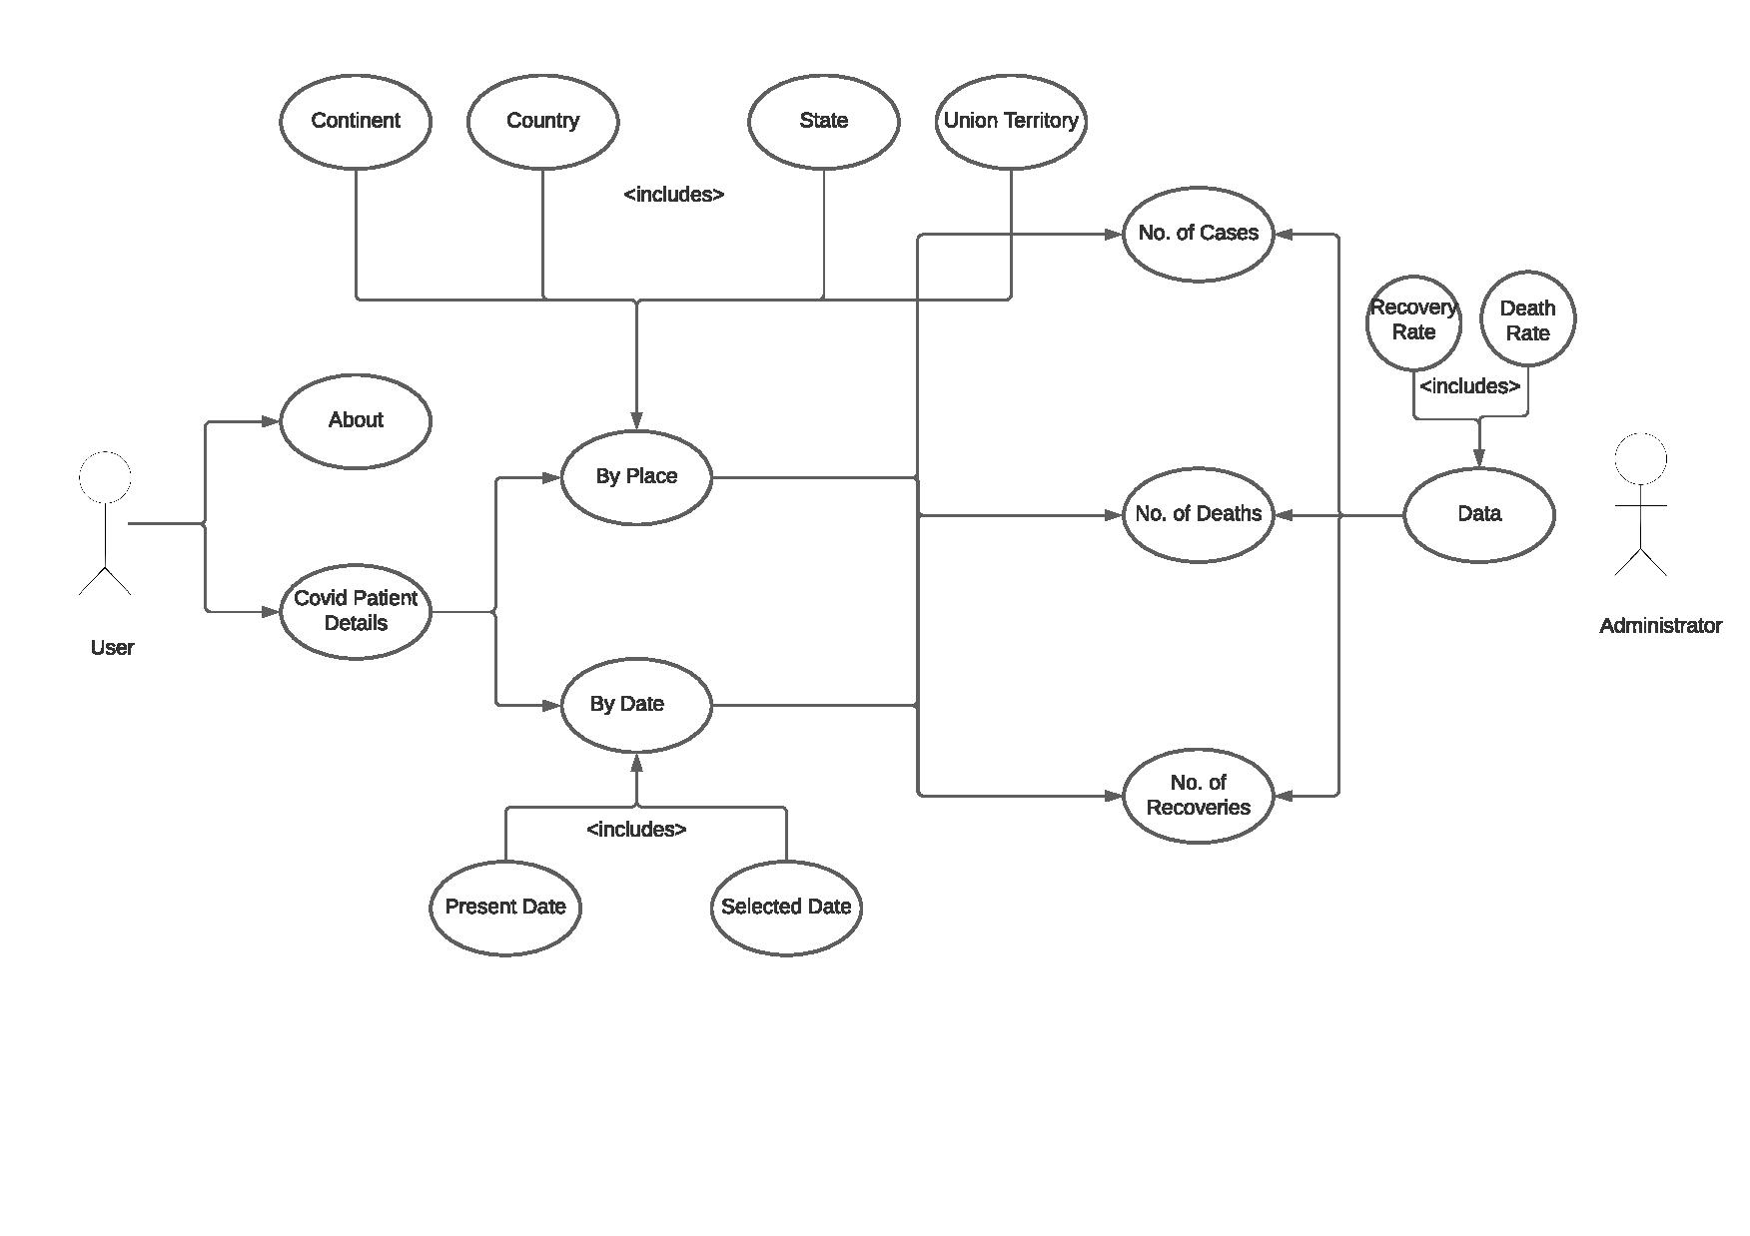
USE CASE DIAGRAM

Slide 4
TECHNOLOGY USED:
All computer software needs certain hardware components or other software resources to be present, in order for computers to be used efficiently. These prerequisites are known as System Requirements. Within this, we have two types – Software Requirements and Hardware Requirements.
SOFTWARE REQUIREMENTS
Software Requirements deal with defining the software resource requirements and prerequisites that need to be installed on a computer to provide optimal functioning of an application. These preconditions are generally not included in the software installation package and need to be installed separately.
In order to use CODIAC, one should have the following:
Operating System: Windows 7 and above
C Compiler: GNU Compiler Collection (GCC)
Editor: Vim editor .
HARDWARE REQUIREMENTS
Hardware requirements refer to the common set requirements defined by any operating system or software application and are usually the physical computer resources. In this, we look into the architecture, processing power, memory, secondary memory, display adapter and peripherals.
In order to use this project, one should have the following:
Processor: Intel Pentium processor and above
Memory: 4 GB RAM and above

Slide 5
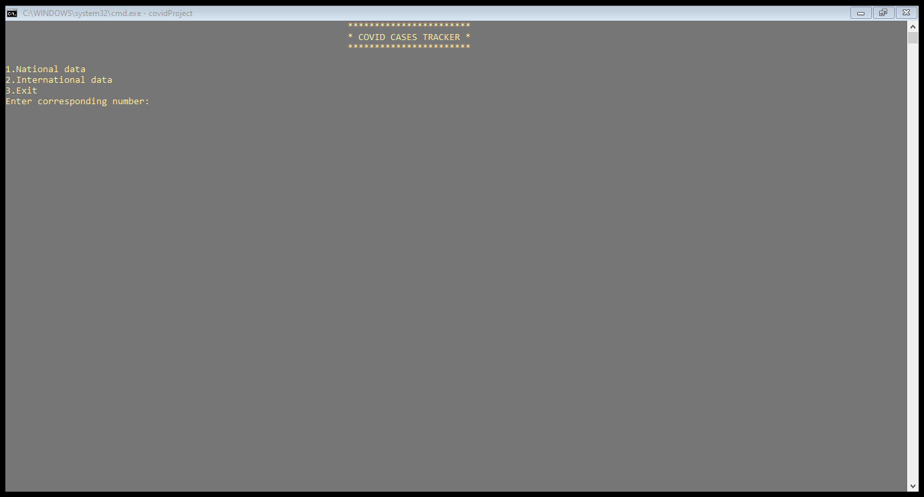
RESULTS:

Slide 6
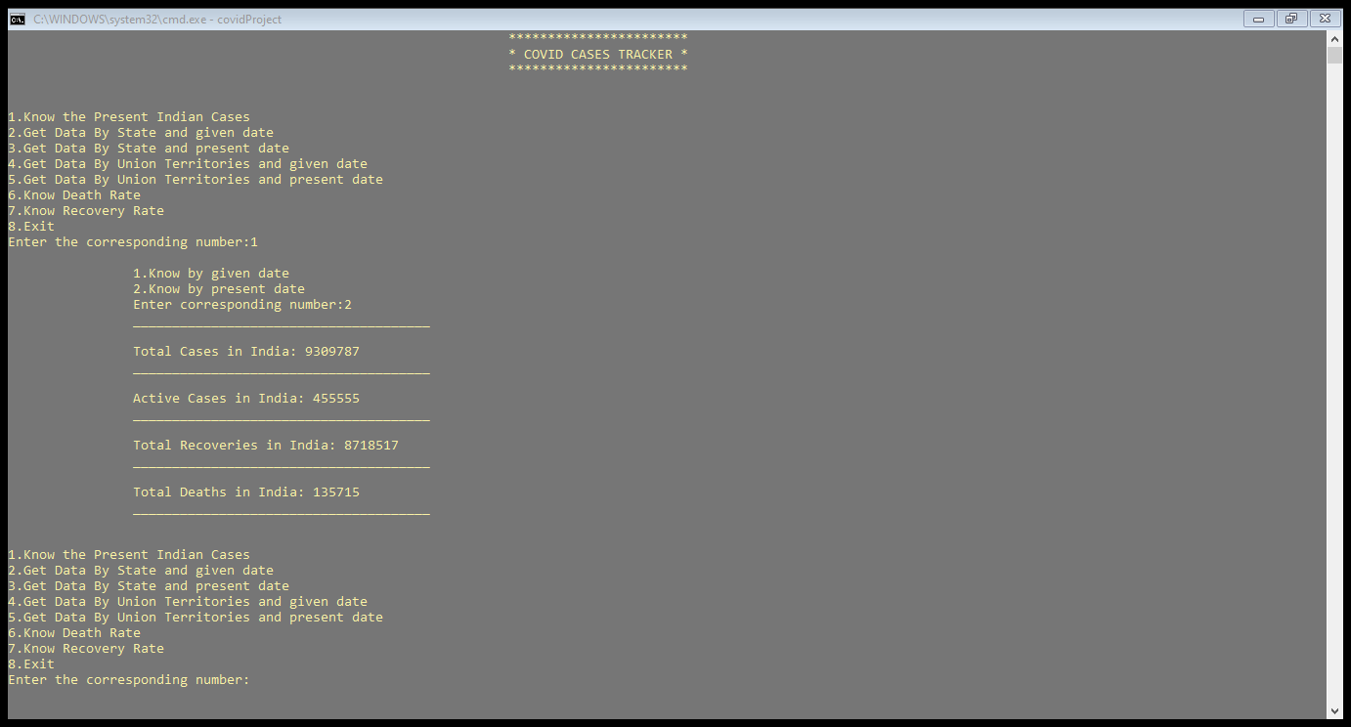

Slide 7
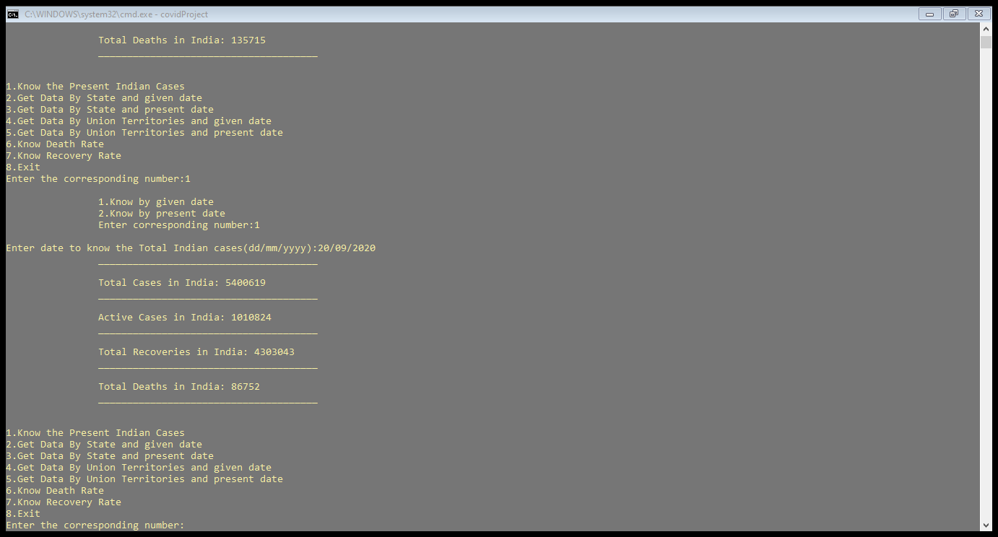

Slide 8
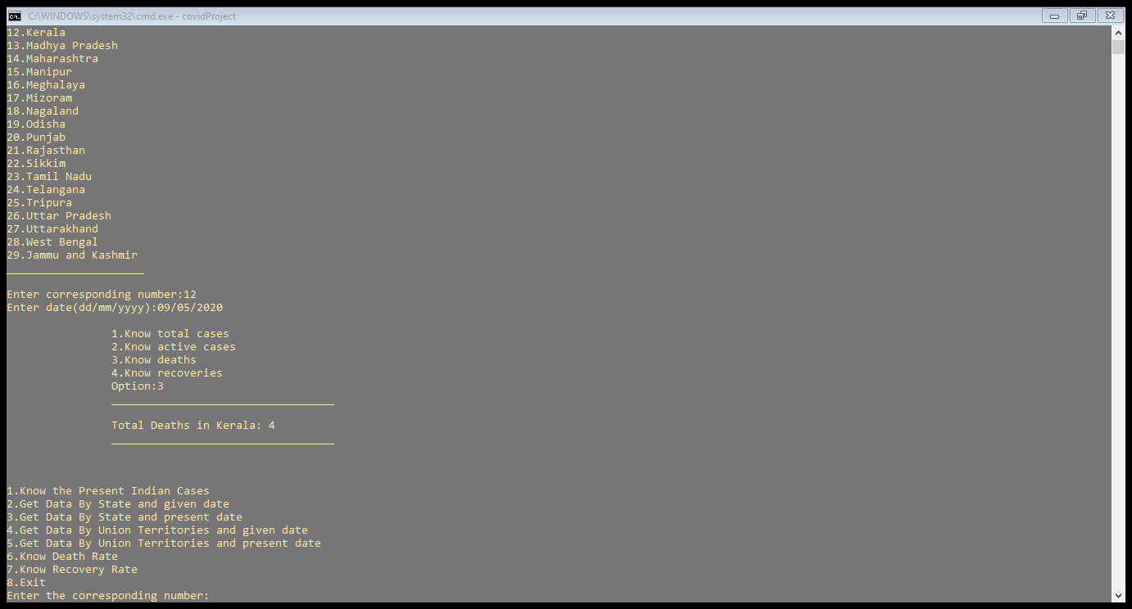

Slide 9
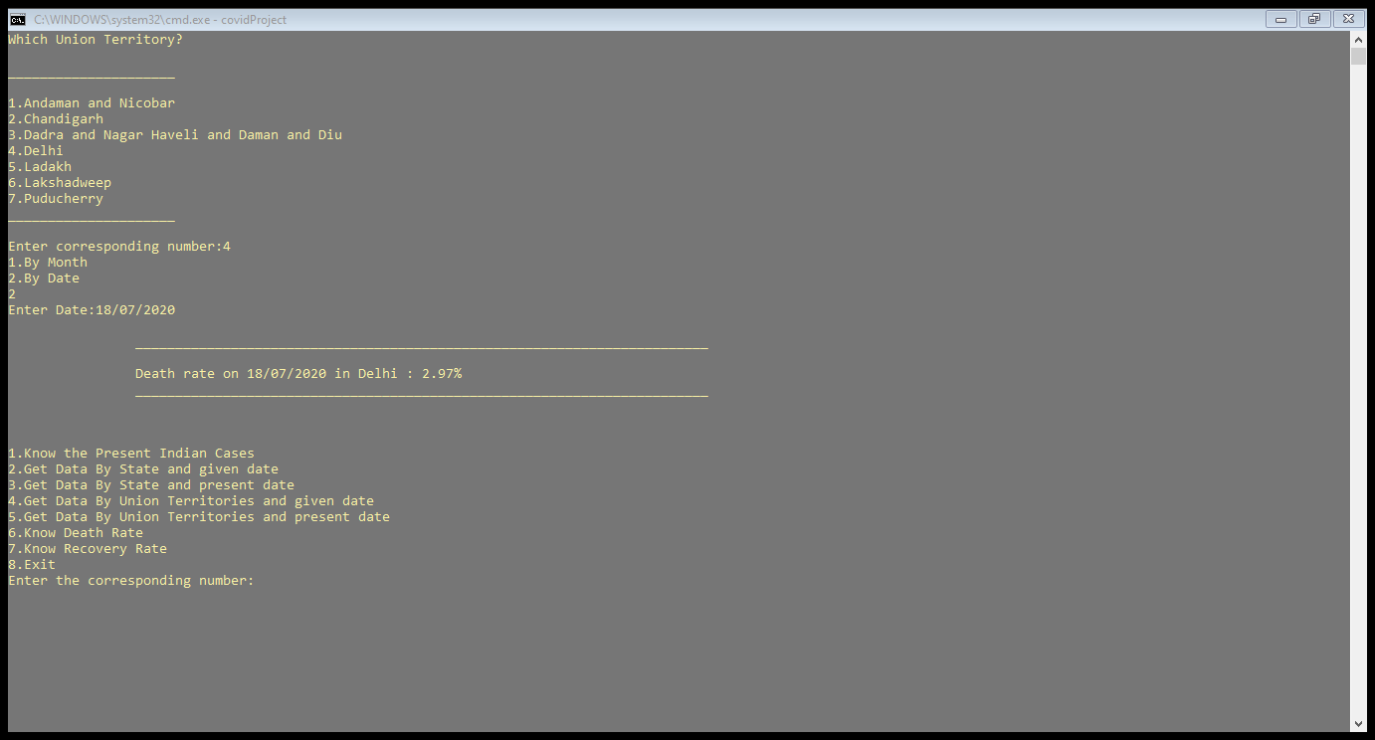

Slide 10
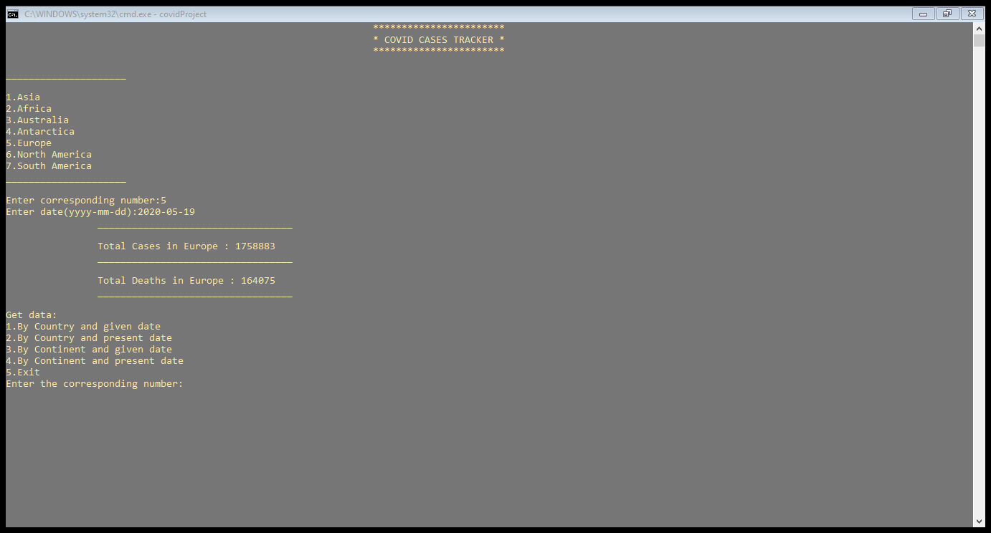

Slide 11
CONCLUSION AND FUTURE WORK:
We conclude that this application is useful for everyone to view number of covid cases in any country/continent across the world.
It can be operated very easily.
Future work is that we wanted to display even current cases at any place and make this console application as a web application.

